Slide 1


WIRELESS NETWORK SECURITY
WEEK 09

Slide 2
LEARNING OUTCOMES
At the end of this session, the learner should be able to:
Explain prevalent wireless network security threats and weaknesses
Identify current tools and techniques for wireless network security analysis
Use identified tools and techniques to analyze wireless network security
Document findings using appropriate visualizations and reports
Provide recommendations to mitigate/correct security deficiencies identified

Slide 3
WIRELESS NETWORK SECURITY PRINCIPLES

Slide 4
WIRELESS
Wireless (unbounded) media is a type of media that is used to transmit data from one point to another without using physical wire connections.
Use different frequencies of the electromagnetic spectrum
Travels at the speed of light.
A transmitting antenna and a receiver aerial used to facilitate communication.
Examples of wireless communication media include:
  Radio waves (low frequency, broadcast over wide area, long distances)
  Microwaves (used for LAN and cellular communications)
  Infrared (line of sight)
WLANs typically use radio waves (e.g. 902 MHz), microwaves (e.g. 2.4 GHz), and infrared (IR) waves (e.g. 820 nm).

Slide 5
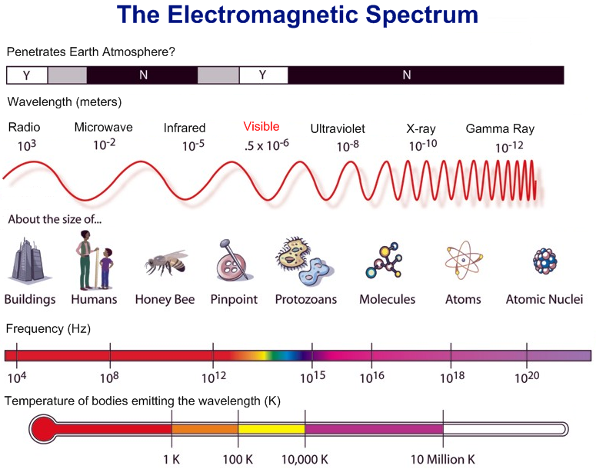
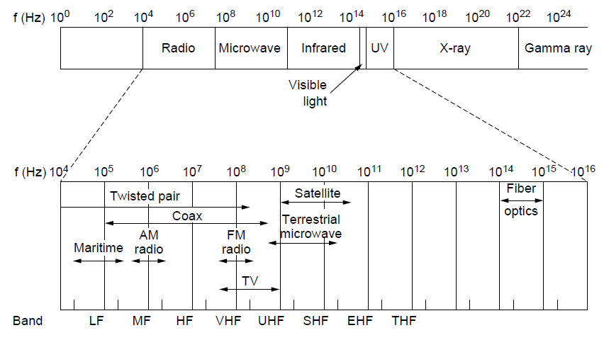

Slide 6
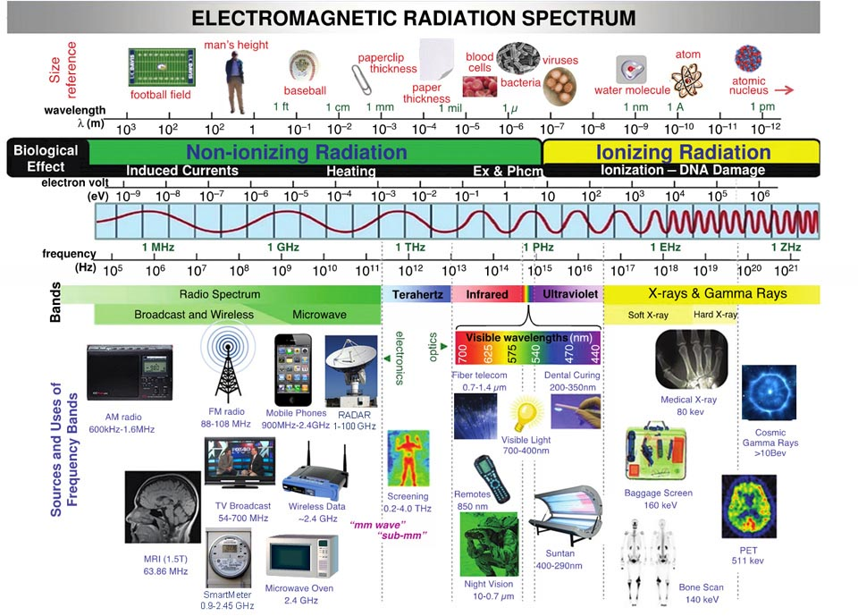

Slide 7
WIRELESS
Advantages
Does not require installation of media. Makes it easy and quick to setup network, looks good without cables and often cheaper to connect multiple users.
Mobility: users can move around freely within the area of the network with their laptops, handheld devices
Scalable: easy for users to join network
Disadvantages
Affected by propagation environment effects e.g. reflection, obstruction by objects, interference.
Lower data transfer speeds as compared to wired networks
Less geographical distance coverage
Less secure, hackers can intercept and sniff data as long as signal is within reach

Slide 8
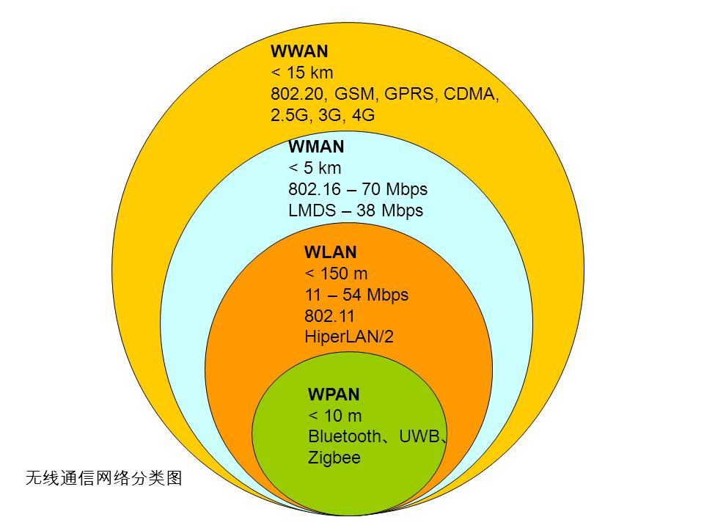
TYPES OF WIRELESS NETWORKS
WPAN - Wireless Personal-Area Networks
WLAN - Wireless LANs
WMAN - Wireless MANs
WWANs - Wireless Wide-Area Networks
Standards
IEEE802.11 - WLAN and WiFi
IEEE802.15 - Bluetooth
IEEE802.16 - WiMax

Slide 9
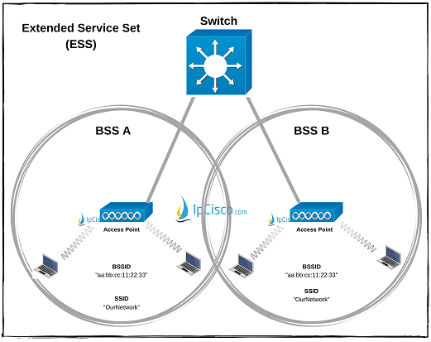
WIRELESS LAN
Provides link-local connection on layers 1 & 2
The topology illustrated:
Basic Service Set (BSS) – central Access Point and its clients
Extended Service Set (ESS) – multiple Access Points in a switched network with same SSID but each AP with its own unique BSSID.
Independent Basic Service Set (IBSS) – clients directly communicating with each other without need of Access Point.

Slide 10
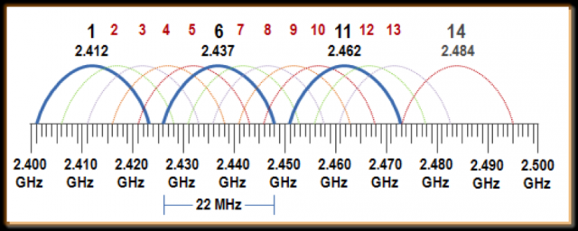
WIRELESS LAN
WiFi uses unlicensed spectrum. License fees are not usually required to operate WiFi equipment. The Industrial, Scientific and Medical (ISM) bands allow for unlicensed use of 2.4-2.5 GHz, 5.8 GHz, and many other (non-WiFi) frequencies.
WiFi devices must use the same channel in order to communicate with each other. They send and receive on the same channel, so only one device may transmit at any time. This kind of connection is called half-duplex.

Slide 11
IEEE 802.11 WLAN STANDARDS
*Wi-Fi 7 - 802.11be expected in 2024
Characteristic | 802.11 | 802.11a | 802.11b | 802.11g | 802.11n Wi-Fi 4 | 802.11ac Wi-Fi 5 | 802.11ax Wi-Fi 6
 | Sept 97 | Sept 99 | Dec 99 | June 2003 | Sept 2009 | Dec 2013 | Feb 2021
Spread Spectrum Method, etc. | FHSS | OFDM | DSSS | OFDM | OFDM + MIMO | OFDM + MIMO | OFDMA
Unlicensed Band | 2.4 GHz | 5 GHz | 2.4 GHz | 2.4 GHz | 2.4 GHz and 5 GHz | 5 GHz only | 2.4 GHz, 5 GHz and 6 GHz
Rated Speed | 2 Mbps | 54 Mbps | 11 Mbps | 54 Mbps | 100 to 600 Mbps | 433 Mbps to 6.93 Gbps | 600Mbps to 9.6Gbps
Actual Throughput, 3 m | 1 Mbps | 25 Mbps | 6 Mbps | 25 Mbps | 70-80 Mbps | Closer to rated speed than earlier standards
Actual Throughput 30 m | ? | 12 Mbps | 6 Mbps | 20 Mbps | 50 Mbps | 70-100 Mbps
Remarks | Dead and gone | Little market acceptance | Bloomed briefly | Now obsolete | Today’s dominant 802.11 standard | Growing rapidly | Latest, higher user density near 10G

Slide 12
WIRELESS ENCRYPTION PROTOCOLS
WEP (Wired Equivalent Privacy) - the first Wi-Fi security protocol approved in September 1999. Highly vulnerable. Keys are easy to crack.
WPA (Wi-Fi Protected Access) - temporary replacement of WEP. Provides two modes: WPA-Enterprise and WPA-Personal
  WPA Personal - pre-shared key given to users for access
  WPA Enterprise - utilizes authentication server e.g. RADIUS to give unique username and passwords to users
WPA2 (Wi-Fi Protected Access version 2) – In 2004, introduced improvements to WPA, notably stronger encryption using AES
WPA3 introduced in 2018 gives the highest security and performance

Slide 13
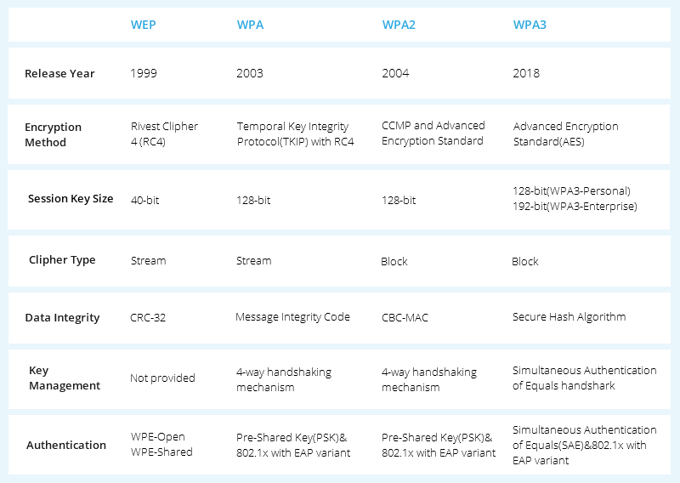
WIRELESS ENCRYPTION PROTOCOLS

Slide 14
WIRELESS LAN SECURITY

Slide 15
WIFI SECURITY THREATS
Hidden or Rogue Access Points – a foreign AP that has been connected to the network used by attackers to trick wireless clients to associate with the rogue AP instead of the legitimate one. The rogue AP allows the attacker to capture data and acts as an entry point into the network. Attacker would need physical access to the network to connect the rogue AP.
Honeypot/Evil Twin APs – An Evil Twin AP presents the same SSID as a genuine hotspot or Wi-Fi network, causing nearby wireless clients to connect to them. Certain tools listen to network traffic and discover which SSIDs wireless clients are willing to connect to, and automatically start broadcasting those SSIDs. After a client connects, DHCP and DNS are used to route the client traffic through the Evil Twin, where local malicious Web, mail, and file servers execute man-in-the-middle attacks.
Rogue Clients – A rogue client is a device that is not authorised to operate on the network but is doing so anyway. Any device connected to rogue AP is automatically considered a rogue client.
Notes:
https://www.alcolizer.com/white_paper/security-in-bluetooth-and-wi-fi-within-portable-electronic-devices/

Slide 16
WIFI SECURITY THREATS
Misconfigured APs – APs that are individually managed pose a significant security threat when configured incorrectly. Most enterprise wireless networks are centrally managed, which facilitates regular updates, audits, and improved reliability. Modern Wi-Fi standards such as 802.11n/ac, WPA2/3 Enterprise, PSK, with no WPS (Wi-Fi Protected Setup) add a multitude of settings, not every client supports all these settings, introducing vulnerabilities.
Ad hoc Connections, Internet Connection Sharing and Bridging Clients – When a device shares its Internet connection or allows access to multiple networks simultaneously, it can be used to bypass network and security systems which may result in data loss or provide an attacker with entry into the network.
Network Jamming as a Denial of Service attack.
Notes:
https://www.alcolizer.com/white_paper/security-in-bluetooth-and-wi-fi-within-portable-electronic-devices/

Slide 17
WIFI SECURITY THREATS
Poor Passwords – attackers can intercept a handshake for an access point and crack it offline using password dictionaries. Simple passwords containing dictionary words, or guessable words can be cracked in seconds. Tools like CeWL and RSMangler can create customized dictionaries
WPS (Wi-Fi Protected Setup) - is enabled by default. It is designed to simplify setup of Wi-Fi networks. No configuration is necessary—only a PIN code, often written on the outside of the AP, visible to anyone Also, these PINs are weak. An attacker can easily bruteforce.
Excessive Network Coverage - If there are no restrictions on signal strength, access to wireless networks can be achieved from a neighboring building or public parking lot. Attackers can then conduct various attacks on the LAN from outside the restricted area, without being detected.
Notes:
https://www.alcolizer.com/white_paper/security-in-bluetooth-and-wi-fi-within-portable-electronic-devices/

Slide 18
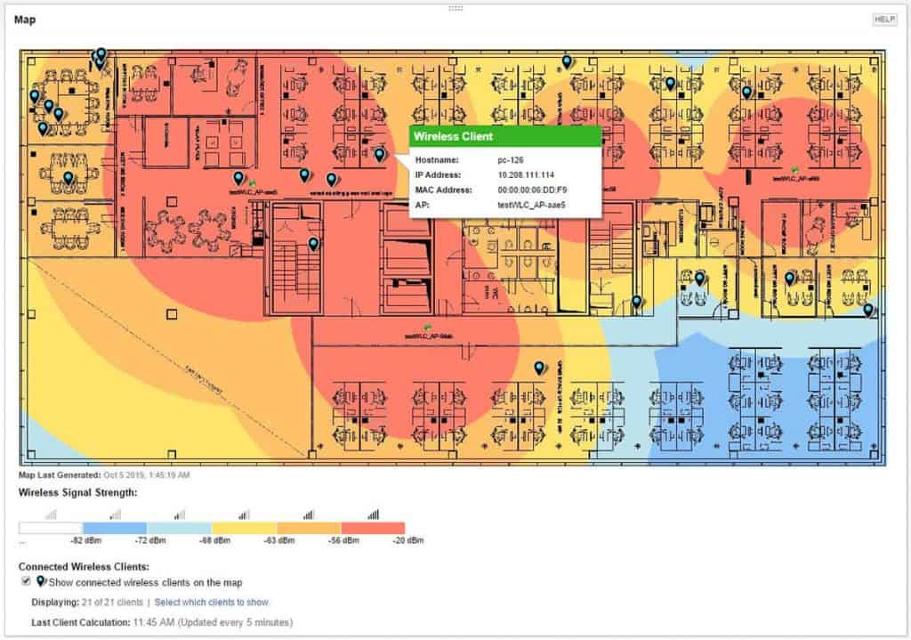
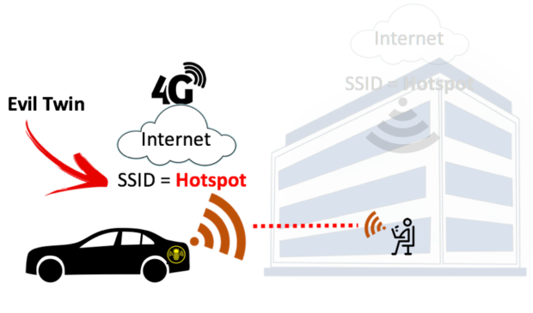
Signal Management and Tracking
Parking Lot Attack
Notes:
WiFi spectrum analysis

Slide 19
BLUETOOTH ATTACKS
BlueSmacking is a DoS attack for Bluetooth devices.
BlueJacking –resembles the spam and phishing attacks seen with email sending unsolicited messages to the device. While the messages themselves do not directly cause harm to the user’s device, they may tempt the user to interact in some way or add the new contact to their address book. Bluejacking can be harmful when a user initiates a response to a Bluejacking message sent with malicious intent.
BlueSnarfing –enables an attacker to gain access to a Bluetooth device by exploiting a firmware vulnerability in older devices. This attack forces a connection to a device, allowing the attacker access to data stored locally on the device including the device’s IMEI. This is a unique identifier that could potentially be used to route incoming traffic from the user’s device to the attacker’s device.
Notes:
https://vpnoverview.com/privacy/devices/bluetooth/
https://www.nist.gov/publications/guide-bluetooth-security-2

Slide 20
BLUETOOTH ATTACKS
BlueBugging – exploits a vulnerability in the firmware of some older Bluetooth devices to gain access to the device and its commands. Attackers can spy on your activity, access your sensitive information, and even use your device to impersonate you on any apps on your device, including the apps you use for online banking.
BlueBorne - a severe vulnerability that allows hackers to take control of multiple devices within the Bluetooth range without any user interaction. It affects various operating systems, including Android, iOS, Windows, and Linux. It takes advantage of the way devices automatically connect to each other and propagates malware across different devices.
Notes:
https://vpnoverview.com/privacy/devices/bluetooth/
https://www.nist.gov/publications/guide-bluetooth-security-2

Slide 21
DATABASE SECURITY ASSESSMENT
In this section we assess Wi-Fi security using aircrack-ng suite of tools https://academy.hackthebox.com/

Slide 22
WI-FI SECURITY ASSESSMENT STEPS
Configure Wi-Fi adapter
Gather Access Point Information
De-authenticate Client
Capture 4-Way Handshake
Brute-Force Password

Slide 23
AIRCRACK-NG SUITE
Aircrack-NG is like a Swiss Army knife for WiFi security.
Available https://github.com/aircrack-ng/aircrack-ng
Consists variety of tools including:
Airmon-ng: Sets wireless NIC into monitor mode which facilitates the capture of network packets without the need for authentication with access point.
Airodump-ng: packet capture utility, recording and storing raw data packets for subsequent analysis. Can fetch coordinates if a GPS is connected for mapping
Aircrack-NG: once sufficient packets are captured using Airodump-ng. It employs statistical, brute force, and dictionary attacks to decrypt WEP/WPA keys

Slide 24
AIRCRACK-NG SUITE
Aireplay-ng: introduces artificial traffic to wireless networks, either by capturing live traffic or injecting packets from an existing file. Can fake authentication, packet injection, and the caffe-latte attack.
Airbase-ng: transforms an attacker’s computer into a rogue access point. This tool enables the simulation of a legitimate access point, paving the way for man-in-the-middle attacks on connected devices.

Slide 25
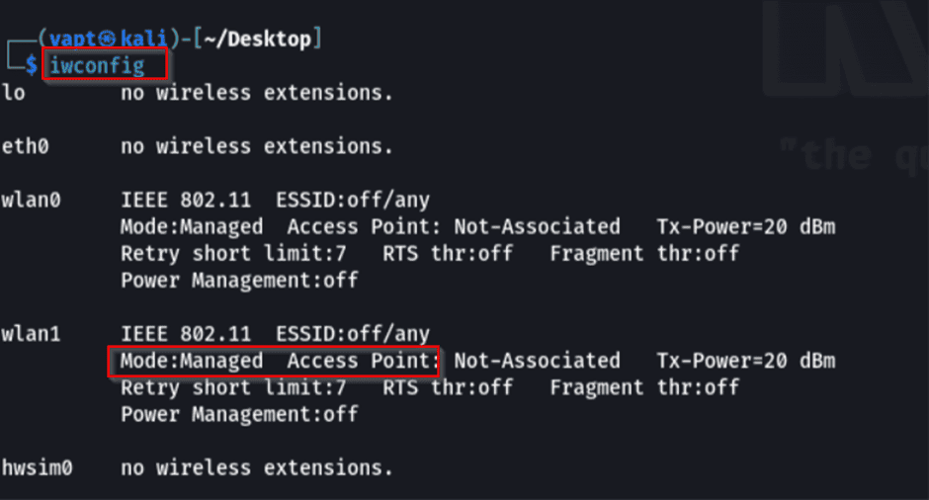
WIFI SECURITY ASSESSMENT

Slide 26
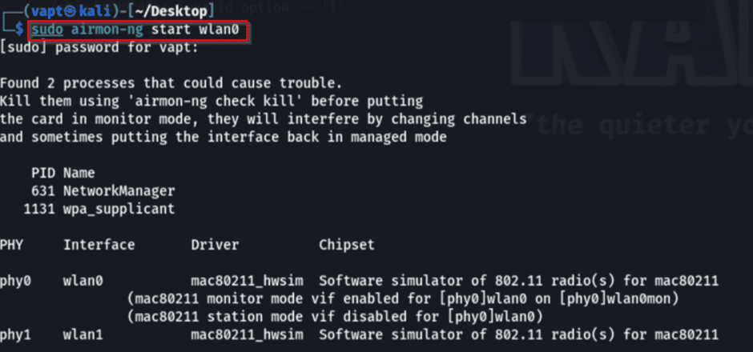
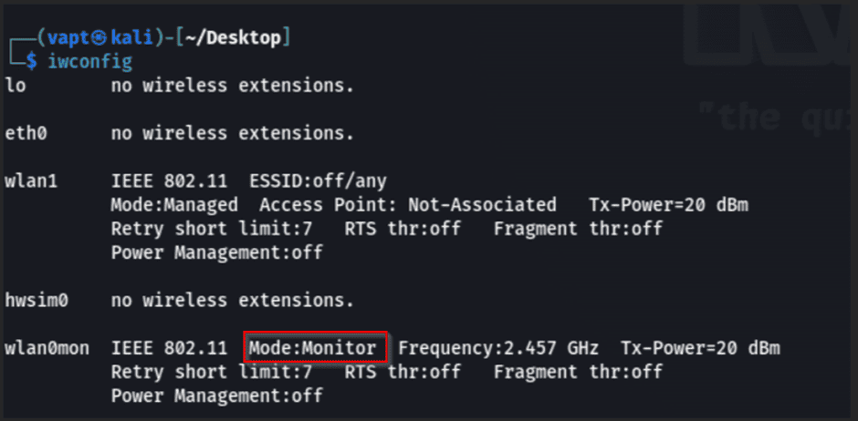
WIFI SECURITY ASSESSMENT

Slide 27

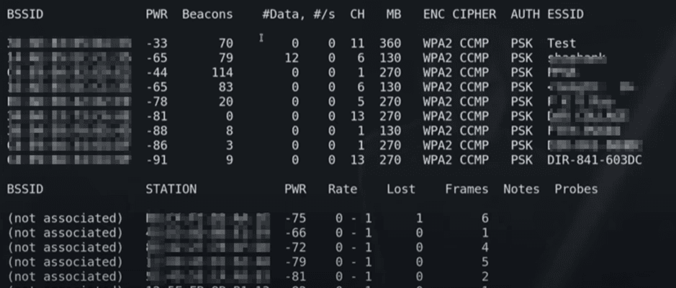
WIFI SECURITY ASSESSMENT

Slide 28
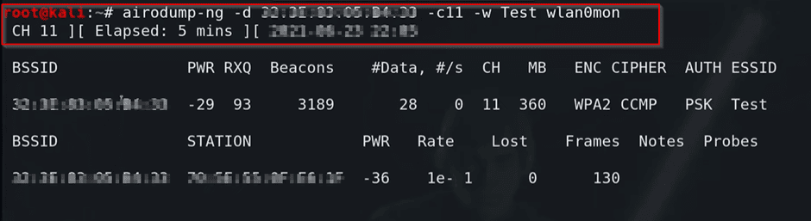
WIFI SECURITY ASSESSMENT
airodump-ng -d 'bssid' -c 'channel' -w test wlan0mon
This command utilizes ‘airodump-ng’ to capture detailed information about the selected Wi-Fi network, saving the results in a file named ‘test’ for further analysis.

Slide 29
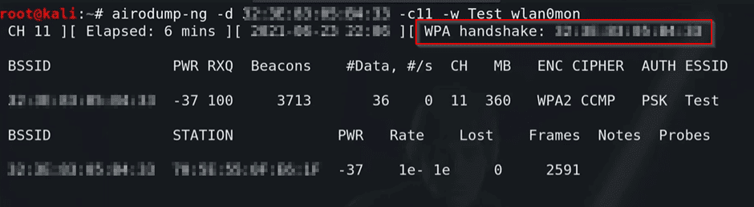
WIFI SECURITY ASSESSMENT
airplay-ng --deauth 0 -a <AP mac> -c <client mac> wlan0mon
This command utilizes performs de-authentication attacks on the specified target access point and client, disrupting their connection.
A handshake will be captured in the initial terminal, which can later be utilized for potential cryptographic key cracking

Slide 30
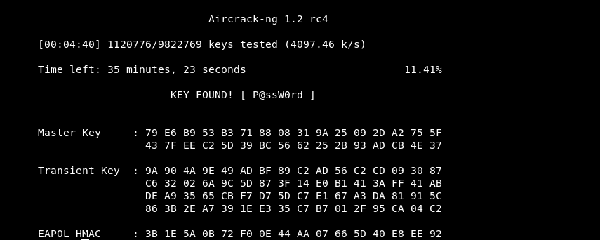
WIFI SECURITY ASSESSMENT
aircrack-ng -b [bssid] -w [word list] [path to packets capture]

Slide 31
WI-FI SECURITY MEASURES

Slide 32
WIFI SECURITY MEASURES
Encrypt using WPA2 or WPA3. Remove WPS, Prefer Enterprise over PSK
Change default SSID and passwords.
Use long passwords including spaces and special characters (e.g. $)
Don’t have SSIDs that are personally identifiable
Turn off AP discoverability e.g. by hiding SSID
Turn off WiFi connectivity when not in use.
Reduce signal strength and manage the geographical signal reach
Use MAC filtering and also narrow pool of DHCP addresses allocatable

Slide 33
WIFI SECURITY MEASURES
If you use public Wi-Fi hotspots on a regular basis, use a Virtual Private Network, which will encrypt all transmissions between your device and the internet.
When transmitting sensitive information, using your mobile phone data plan instead of Wi-Fi may be more secure.
Ensure to use "https" so that transmitted data will be encrypted. Use app add-on that forces your web browsers to use encryption when connecting to websites.
Check the validity of Wi-Fi hotspots especially If more than one hotspot appears claiming to belong to an establishment that you're in to avoid rouge hotspots.
Adjust your settings so it does not automatically connect to nearby Wi-Fi networks. This gives you more control over where and when you connect.

Slide 34
BLUETOOTH SECURITY
Update Bluetooth devices and install security patches and updates.
Use strong unique passwords
Make your Bluetooth device not discoverable.
Don’t share sensitive information via Bluetooth.
Be careful who you connect with.
Turn your Bluetooth off if not in use
Don’t pair devices in public.
Unpair devices as needed.

Slide 35
QUESTIONS

